Slide 1
COMPUTER NETWORKS
Physical Layer
UNIT-1

Slide 2
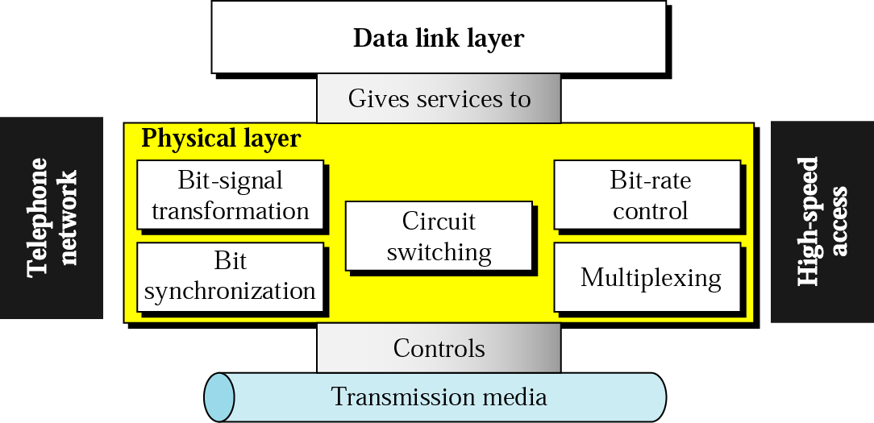
Position of the physical layer

Slide 3
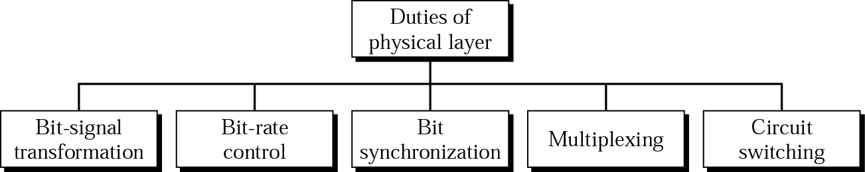
Services

Slide 4
Flow of DATA in Network
Communication between two devices can be in following modes:
  Simplex
  Half Duplex
  Full Duplex

Slide 5
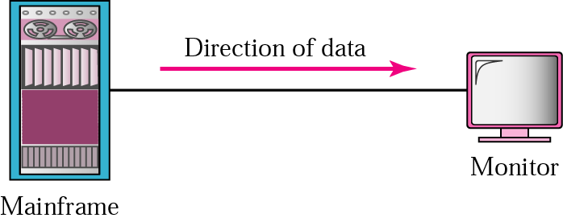
Figure Simplex Mode

Slide 6

Figure Half-duplex

Slide 7

Figure Full-duplex Mode

Slide 8
Signals

Slide 9

Note:
To be transmitted, data must be transformed to electromagnetic signals.

Slide 10
Note:
Signals can be analog or digital. Analog signals can have an infinite number of values in a range; digital signals can have only a limited number of values.

Slide 11
Data & Signals
Analog and Digital Data
  Information i.e. continuous is..
  Information i.e. discrete is..
Analog and Digital Signals
  Signals can have an infinite number of values in a range;
  Signals can have only a limited number of values.

Slide 12
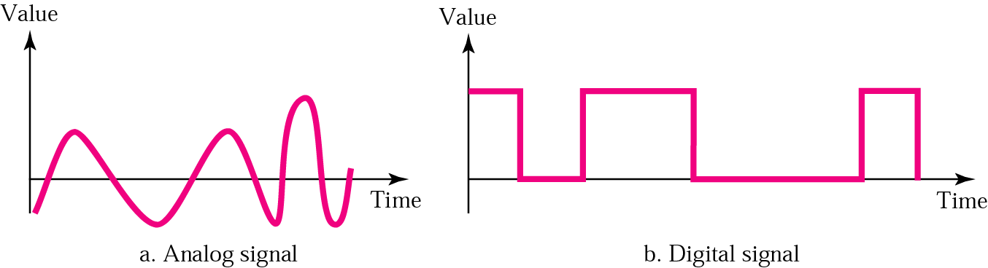
Figure Comparison of analog and digital signals

Slide 13
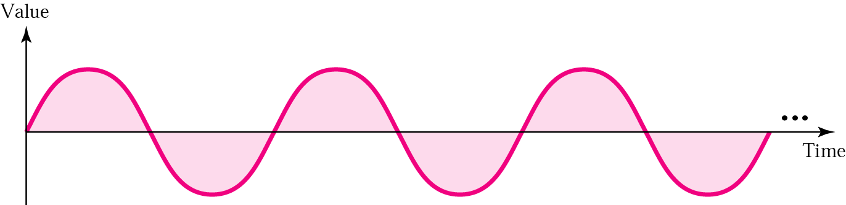
Figure A sine wave:

Slide 14
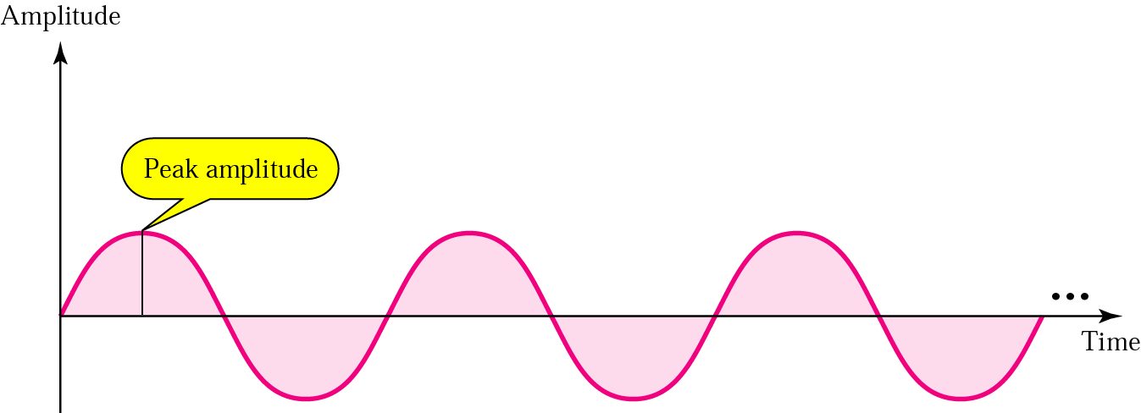
Figure Amplitude

Slide 15
Frequency:
Frequency is the rate of change with respect to time. Change in a short span of time means high frequency. Change over a long span of time means low frequency.

Slide 16
Note:
If a signal does not change at all, its frequency is zero. If a signal changes instantaneously, its frequency is infinite.

Slide 17
Phase:
Phase describes the position of the waveform relative to time zero.

Slide 18
Note:
Frequency and period are inverses of each other.

Slide 19
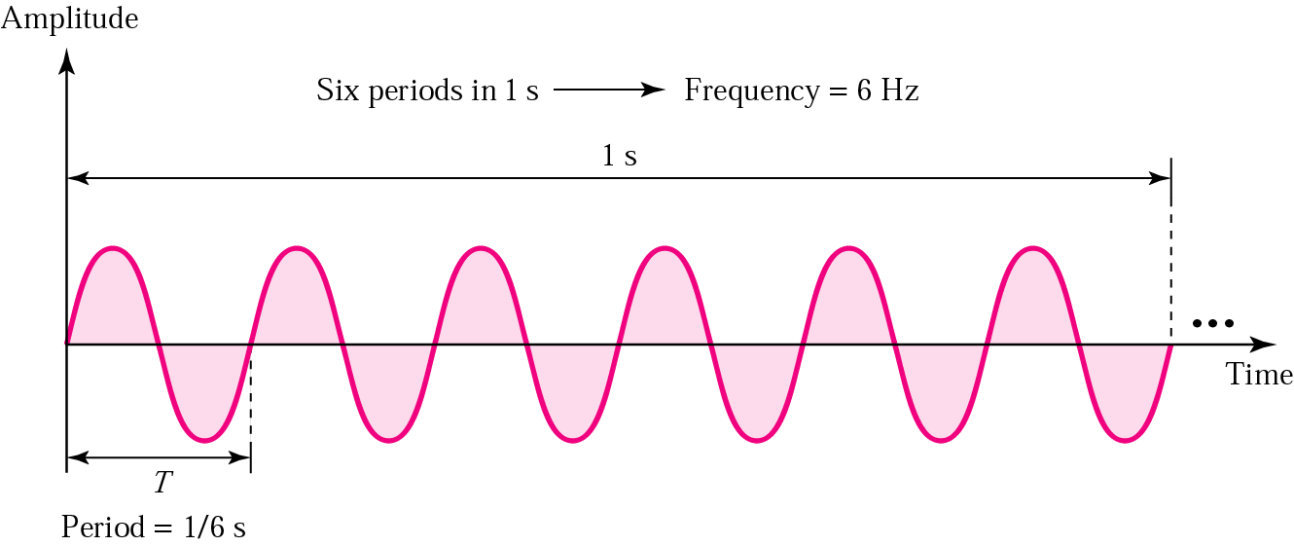
Figure Period and frequency

Slide 20
Table Units of periods and frequencies
Unit | Equivalent | Unit | Equivalent
Seconds (s) | 1 s | hertz (Hz) | 1 Hz
Milliseconds (ms) | 10^{–3} s | kilohertz (KHz) | 10³ Hz
Microseconds (ms) | 10^{–6} s | megahertz (MHz) | 10⁶ Hz
Nanoseconds (ns) | 10^{–9} s | gigahertz (GHz) | 10⁹ Hz
Picoseconds (ps) | 10^{–12} s | terahertz (THz) | 10¹² Hz

Slide 21
Example 1
Express a period of 100 ms in microseconds, and express the corresponding frequency in kilohertz.
Solution
Do by your own

Slide 22
Solution:
We find the equivalent of 1 ms.We make the following substitutions:
100 ms = 100 × 10⁻³ s = 100 × 10⁻³ × 10⁶ μs = 10⁵ μs
Now we use the inverse relationship to find the frequency, changing hertz to kilohertz
100 ms = 100 × 10⁻³ s = 10⁻¹ s
f = 1/10⁻¹ Hz = 10 × 10⁻³ KHz = 10⁻² KHz

Slide 23
Performance of the Communication Channel
Transmission Impairments and Latency

Slide 24
Transmission Impairment
Attenuation
Distortion
Noise

Slide 25
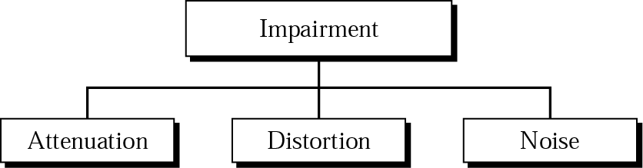
Impairment types

Slide 26
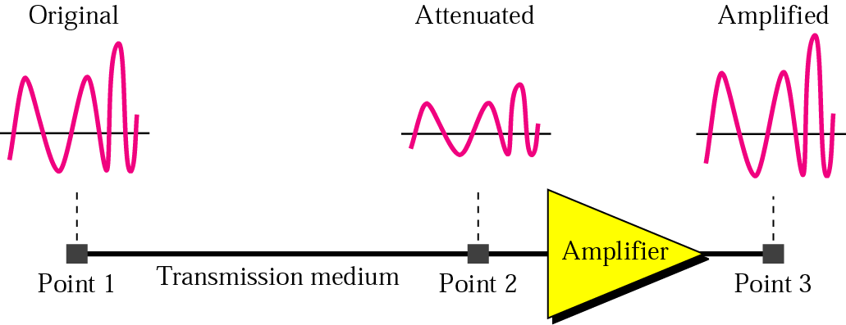
Attenuation: Loss of Power of signal during transmission

Slide 27
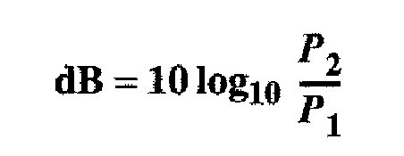
Example
Imagine a signal travels through a transmission medium and its power is reduced to half. This means that P2 = 1/2 P1. In this case, the attenuation (loss of power) can be calculated as
Solution

Slide 28
Solution:
= 10 log₁₀ (P2/P1)
= 10 log₁₀ (0.5P1/P1)
= 10 log₁₀ (0.5)
= 10(–0.3) = –3 dB

Slide 29
Example
Imagine a signal travels through an amplifier and its power is increased ten times. This means that P2 = 10 ¥ P1. In this case, the amplification (gain of power) can be calculated as
10 log₁₀ (P2/P1) = 10 log₁₀ (10P1/P1)
= 10 log₁₀ (10) = 10 (1) = 10 dB

Slide 30
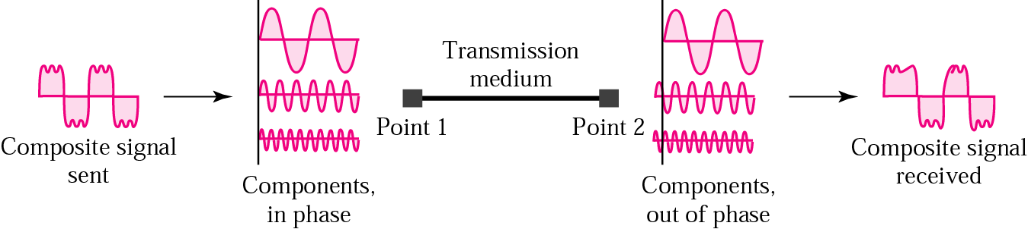
Figure Distortion

Slide 31
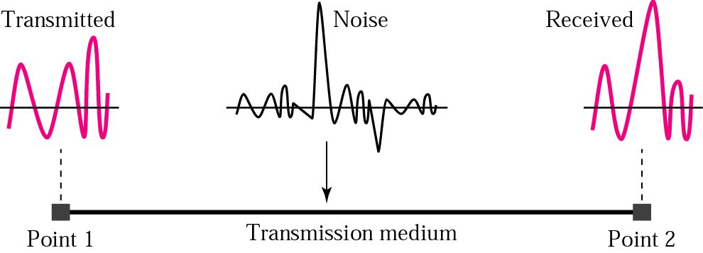
Figure Noise

Slide 32
Noise:
It can be introduced in signals
Can be thermal i.e random motion of electrons in a wire which create extra signal
Signal to Noice Ratio:
  SNR = Avg. Signal Power/ Avr. Noise Power

Slide 33


Slide 34
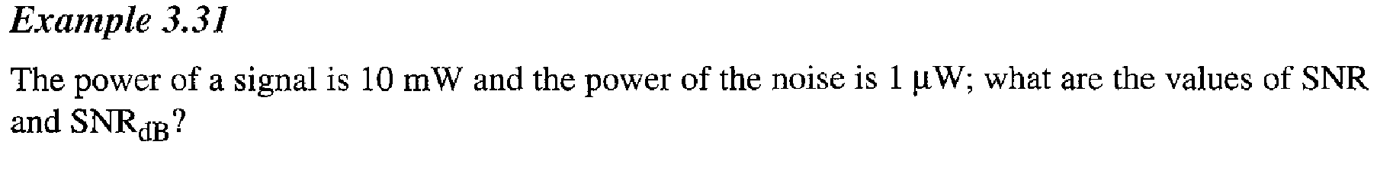
Problem:

Slide 35
More About Signals:
Throughput
Propagation Speed
Propagation Time
Wavelength

Slide 36
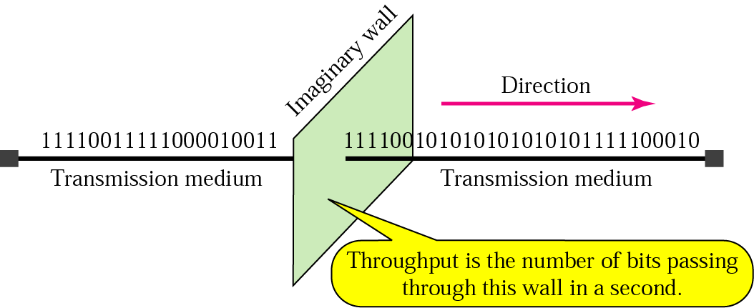
Figure Throughput

Slide 37
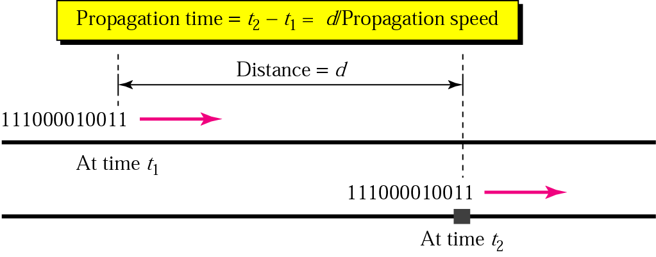
Figure Propagation time

Slide 38
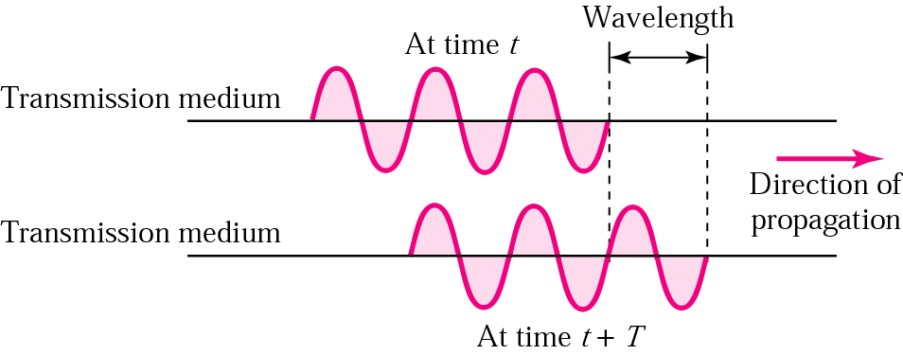
Figure Wavelength

Slide 39
Latency
It defines how long it takes for an entire message to completely arrive at the destination from the time the first bit is sent out from the source.
It includes:
  Propagation Time
  Transmission Time
  Queuing Tiime
  Processing Delay

Slide 40
Latency Cont…
Latency(Delay)
= Propagation time + Transmission time + Queuing Time+ Processing Delay

Slide 41
Problem
What is the Propagation time and transmission time for a 5 MB (Image) if the bandwidth of network is 1 Mbps? The Distance between sender & receiver is 12000 Km and the speed of signal is 2.4 X 10^8 m/s.

Slide 42
Problem:2
Calculate the total latency for transmission if there are 10 number of routers are on the path and processing time for each router is 5 ms and processing delay is 10 ms for each router.

Slide 43
DATA RATE LIMITS
A very important consideration in data communications is how fast we can send data, in bits per second, over a channel. Data rate or Bit Rate depends on three factors:
1. The bandwidth available
2. The level of the signals we use
3. The quality of the channel (the level of noise)
Topics to be discussed:
Noiseless Channel: Nyquist Bit Rate
Noisy Channel: Shannon Capacity
Using Both Limits
3.<number>

Slide 44
Data Rate Limit
Nyquist Bit Rate used for Noiseless Channel: ( Theoretical max bit rate)
Bit Rate = 2 × Bandwidth× log₂ L
L = No. of signal level used to represent the data

Slide 45
Example:
Consider a noiseless channel with a bandwidth of 3000 Hz transmitting a signal with two signal levels. The maximum bit rate can be calculated as
Bit Rate = ?
Bit Rate = 2 × 3000 × log₂ 2 = 6000 bps

Slide 46
Example
Consider the same noiseless channel, transmitting a signal with four signal levels. The maximum bit rate can be calculated as:
Bit Rate = 2 x 3000 x log₂ 4 = 12,000 bps

Slide 47
Data Rate Limit
Shannon Capacity: (Highest Bit rate achievable for Noisy Channel)
Capacity = Bandwidth log₂ (1 + SNR)

Slide 48
Example
Consider an extremely noisy channel in which the value of the signal-to-noise ratio is almost zero. In other words, the noise is so strong that the signal is faint. For this channel the capacity is calculated as
C = B log₂ (1 + SNR) = B log₂ (1 + 0)
= B log₂ (1) = B × 0 = 0

Slide 49
Example
We can calculate the theoretical highest bit rate of a regular telephone line. A telephone line normally has a bandwidth of 3000 Hz (300 Hz to 3300 Hz). The signal-to-noise ratio is usually 3162. For this channel the capacity is calculated as
C = B log₂ (1 + SNR) = 3000 log₂ (1 + 3162)
= 3000 log₂ (3163)
C = 3000 × 11.62 = 34,860 bps

Slide 50
Example
We have a channel with a 1 MHz bandwidth. The SNR for this channel is 63; what is the appropriate bit rate and signal level?
Solution
First, we use the Shannon formula to find our upper limit.
C = B log₂ (1 + SNR) = 10⁶ log₂ (1 + 63) = 10⁶ log₂ (64) = 6 MBps
Then we use the Nyquist formula to find the
number of signal levels.
4 MBps = 2 × 1 MHz × log₂ L ➔ L = 4

Slide 51
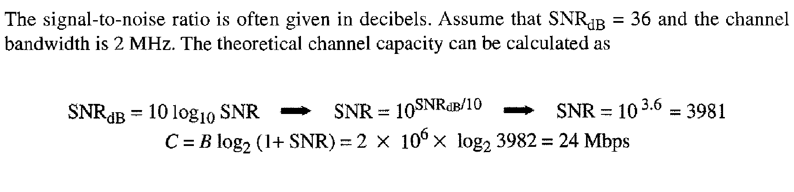
If SNR is given in decibel form then how to calculate Shannon Capacity

Slide 52
Digital
Transmission

Slide 53
Conversion Types
Digital Data to Digital Signal
Analog Signal to Digital Signal

Slide 54
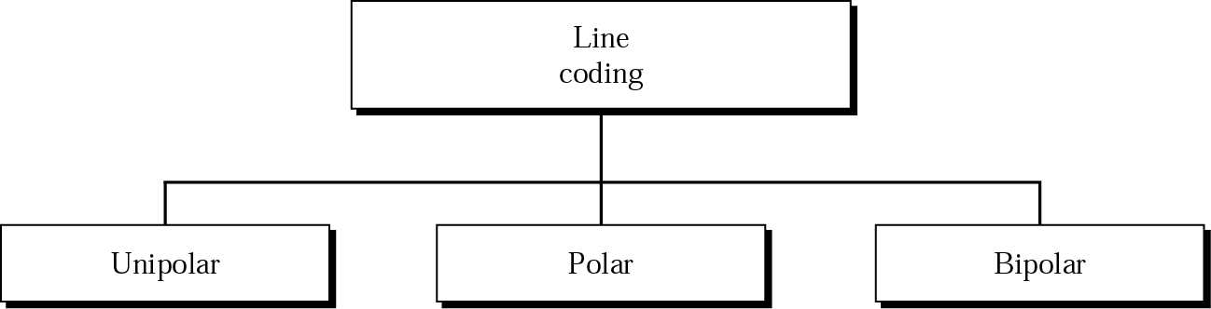
Line coding schemes: Converts digital data to digital signal

Slide 55
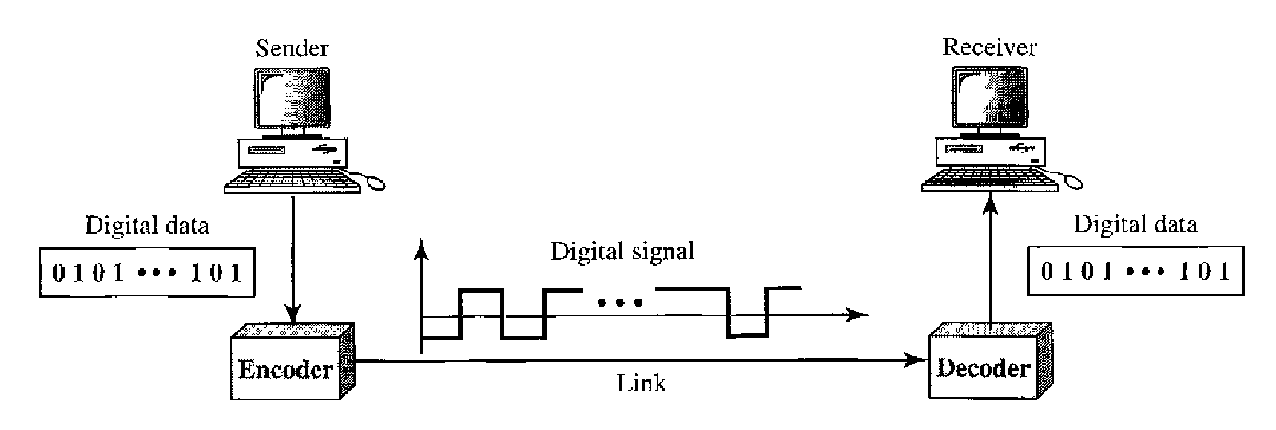

Slide 56
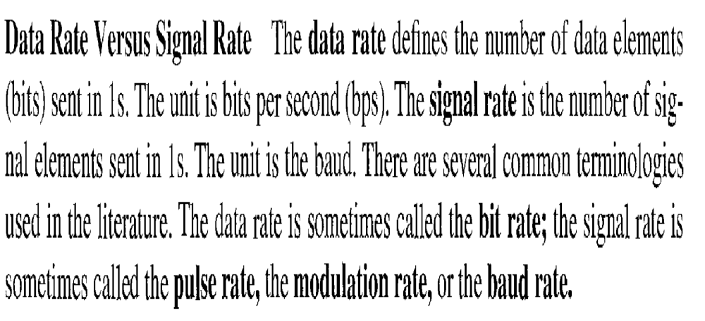
Key Concept of Data & Signal

Slide 57
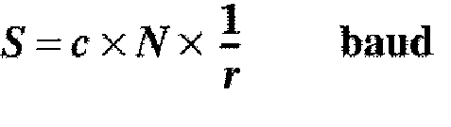
Relation b/w Signal and Data

Slide 58
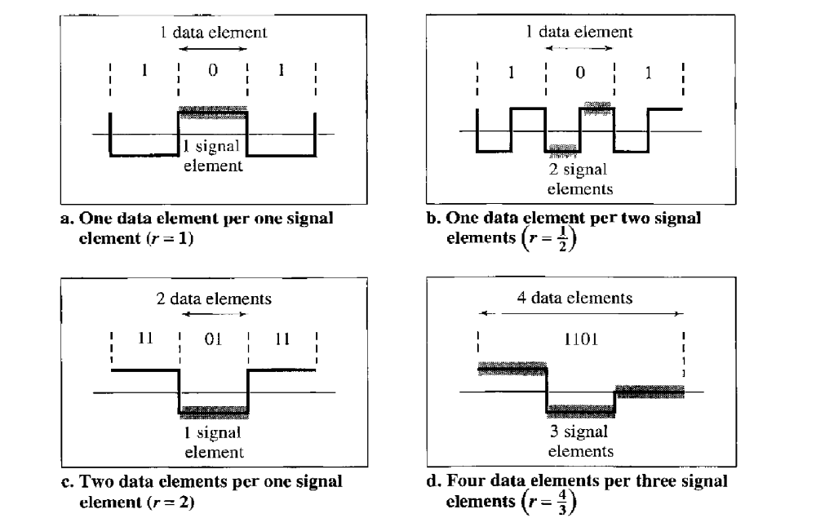
Relationship b/w Signal and Data Elements

Slide 60
Digital-to-digital Conversion cont...
Unipolar encoding uses only one voltage level.

Slide 61
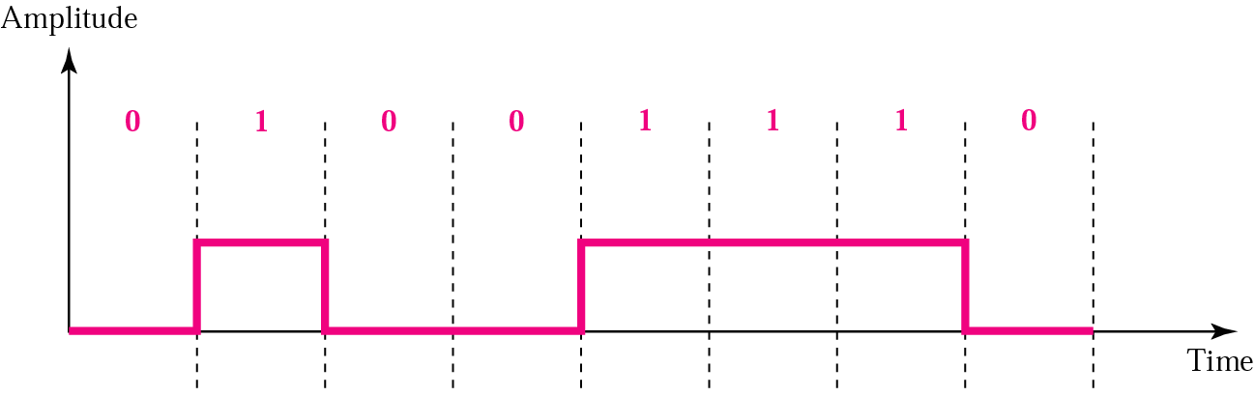
Figure Unipolar encoding

Slide 62
Note:
Polar encoding uses two voltage levels (positive and negative).

Slide 63
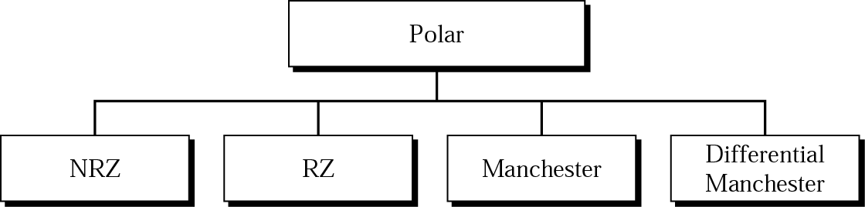
Figure Types of polar encoding

Slide 64
Note:
In NRZ-L the level of the signal/Voltage determines the value of the bit.

Slide 65
Note:
In NRZ-I denotes the change or no change in the signal. If the value is 1 then signal is inverted.

Slide 66
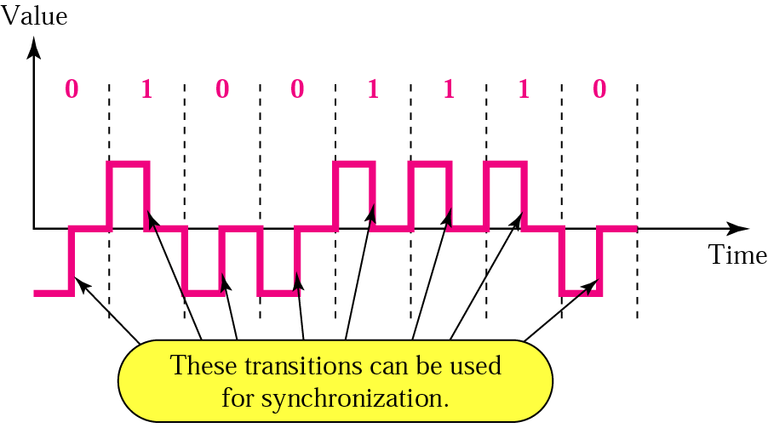
Figure RZ encoding

Slide 67
RZ:
A good encoded digital signal must contain a provision for synchronization.

Slide 68
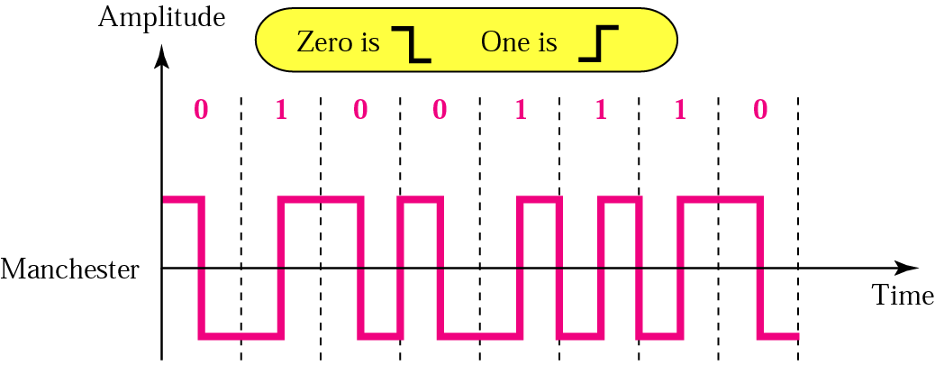
Figure Manchester encoding

Slide 69
Note:
In Manchester encoding, the transition at the middle of the bit is used for both synchronization and bit representation.

Slide 70
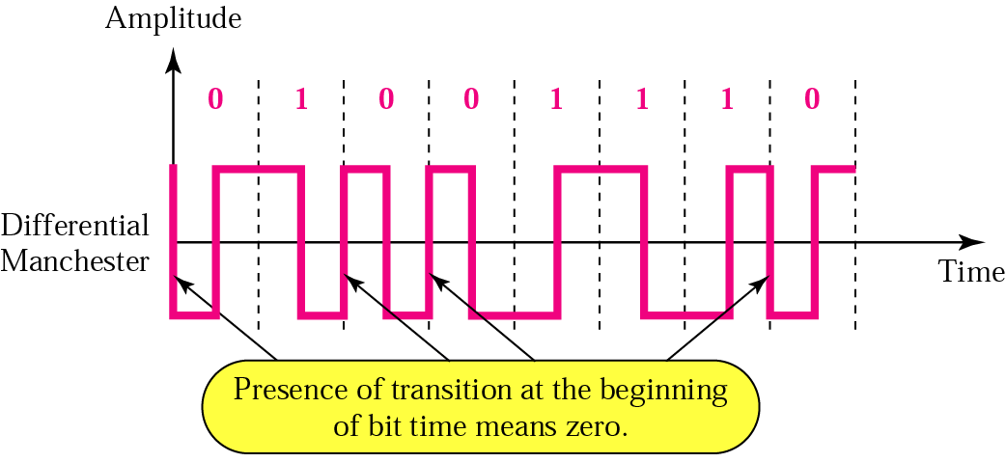
Figure Differential Manchester encoding

Slide 71
Note:
In differential Manchester encoding, the transition at the middle of the bit is used only for synchronization.
The bit representation is defined by the inversion or noninversion at the beginning of the bit.

Slide 72
Practice question:
Bit Seq: 11001010
Bit Seq: 00001111

Slide 73
Analog to Digital Conversion

Slide 74
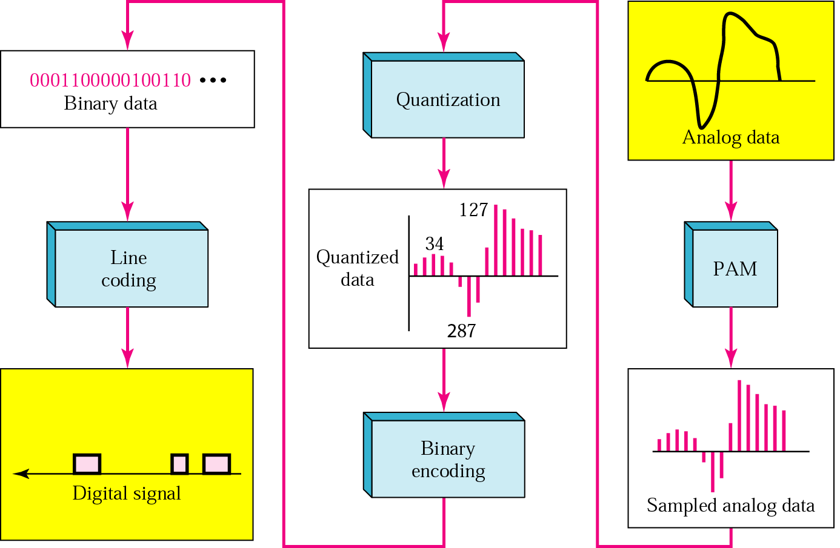
PCM Conversion From analog signal to digital code

Slide 75
Analog to Digital:
Pulse Code Modulation
  Pulse Amplitude Modulation
Delta Modulation

Slide 76
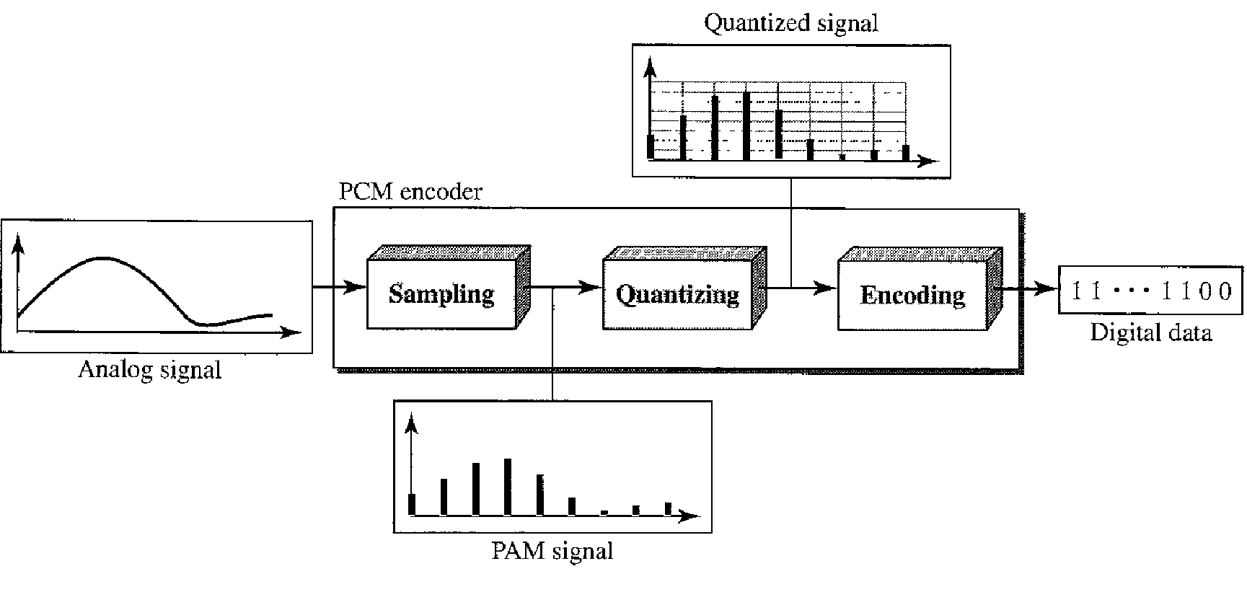

Slide 77
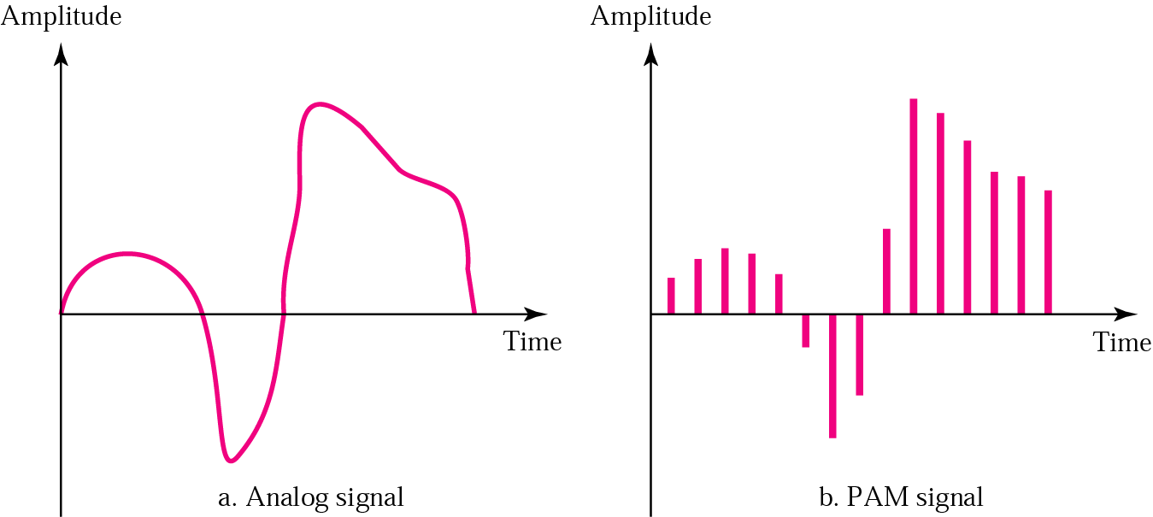
Figure PAM

Slide 78
PCM & PAM:
Pulse amplitude modulation has some applications, but it is not used by itself in data communication. However, it is the first step in another very popular conversion method called
pulse code modulation.

Slide 79
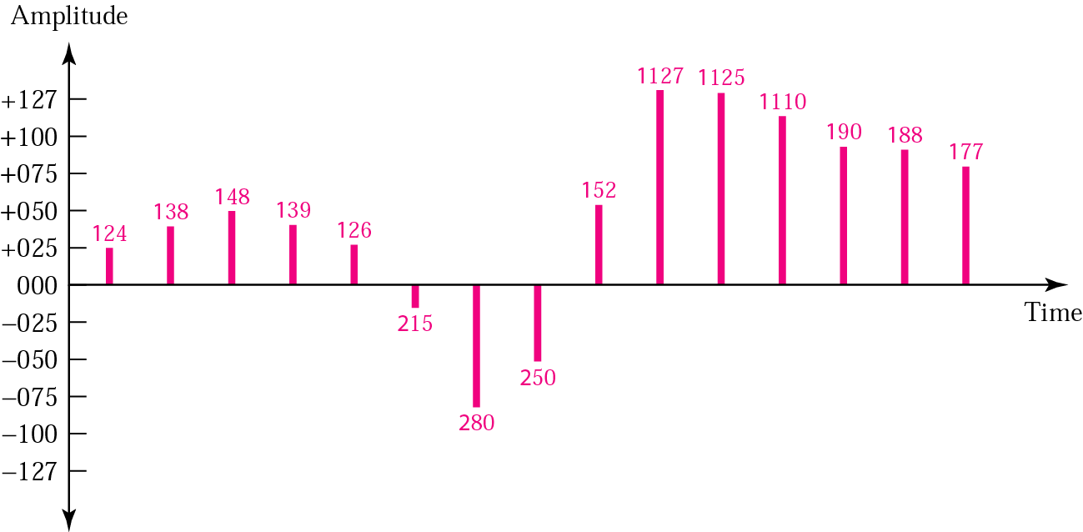
Quantized PAM signal

Slide 80
Sampling & Sampling Rate
Analog signal is sampled every Ts Sec, where Ts is the sampling interval or period.
Sampling Rate (fs) = 1/Ts
Also known as Sampling Frequency

Slide 81
Bit Rate:
Bit Rate = Sampling Rate * No. of bits per Sample

Slide 82
Note:
According to the Nyquist theorem, the sampling rate must be at least 2 times the highest frequency.

Slide 83
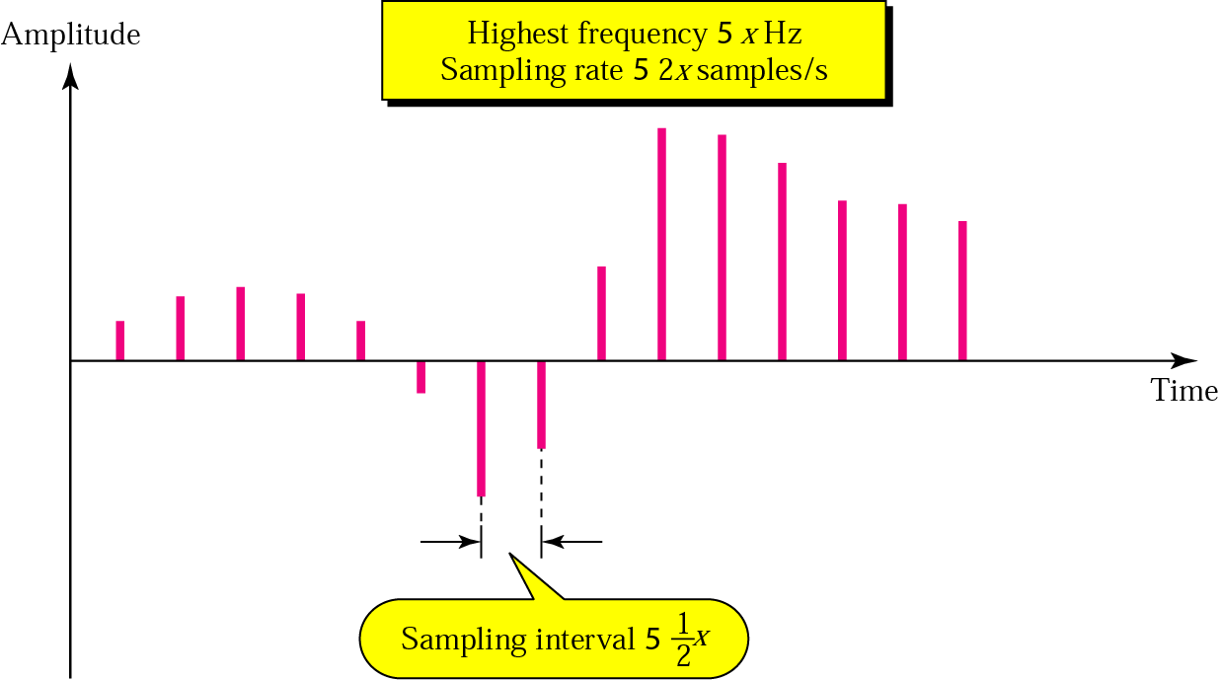
Figure 4.23 Nyquist theorem

Slide 84
Example
What sampling rate is needed for a signal with a bandwidth of 10,000 Hz (1000 to 11,000 Hz)?
Solution

Slide 85
The sampling rate must be twice the highest frequency in the signal:
Sampling rate = 2 x (11,000) = 22,000 samples/s

Slide 86
Example
We want to digitize the human voice. What is the bit rate, assuming 8 bits per sample?
Solution
The human voice normally contains frequencies from 0 to 4000 Hz.
Sampling rate = 4000 x 2 = 8000 samples/s
Bit rate = sampling rate x number of bits per sample
= 8000 x 8 = 64,000 bps = 64 Kbps

